Slide 1
Using Vortex on FPGA
https://github.com/vortexgpgpu/vortex_tutorials
Presenter: Liam Cooper
Notes:
1

Slide 2
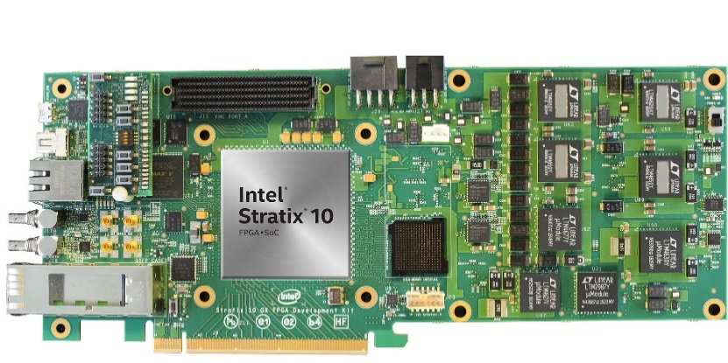
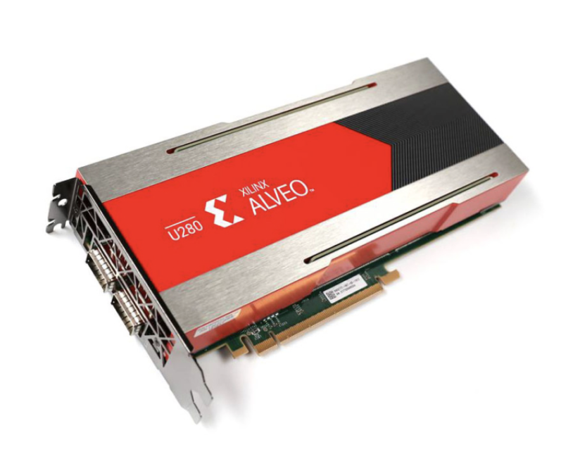
Overview
Supported platforms
Intel Quartus, OPAE
Xilinx XRT
Yosys
Supported FPGAs
Altera Arria 10, Stratix 10
Xilinx Alveo U50, U250, U280
Xilinx Versal VCK5000
Configurations synthesized on Stratix 10
8 cores, each with 32 warps and 32 threads per warp
16 cores, each with 8 warps and 8 threads per warp
Notes:
2

Slide 3
Synthesis for Xilinx FPGAs
Requires Xilinx XRT to be installed
The directory hw/syn/xilinx/xrt contains makefile for synthesis
Vortex hardware configuration and target Xilinx platform passed to makefile
Xilinx hardware emulation supported
vitis_analyzer used for viewing area and timing reports
To run a program on Vortex via FPGA, use blackbox script
Specify xrt for driver option
Notes:
3

Slide 4
Synthesis for Altera FPGAs
Requires Intel Quartus and OPAE to be installed
The directory hw/syn/altera/opae contains makefile for synthesis
Vortex hardware configuration and FPGA family name passed to makefile
Scripts for generating area, power, and timing reports
To run a program on Vortex via FPGA, use blackbox script
Specify opae for driver option
Notes:
4

Slide 5
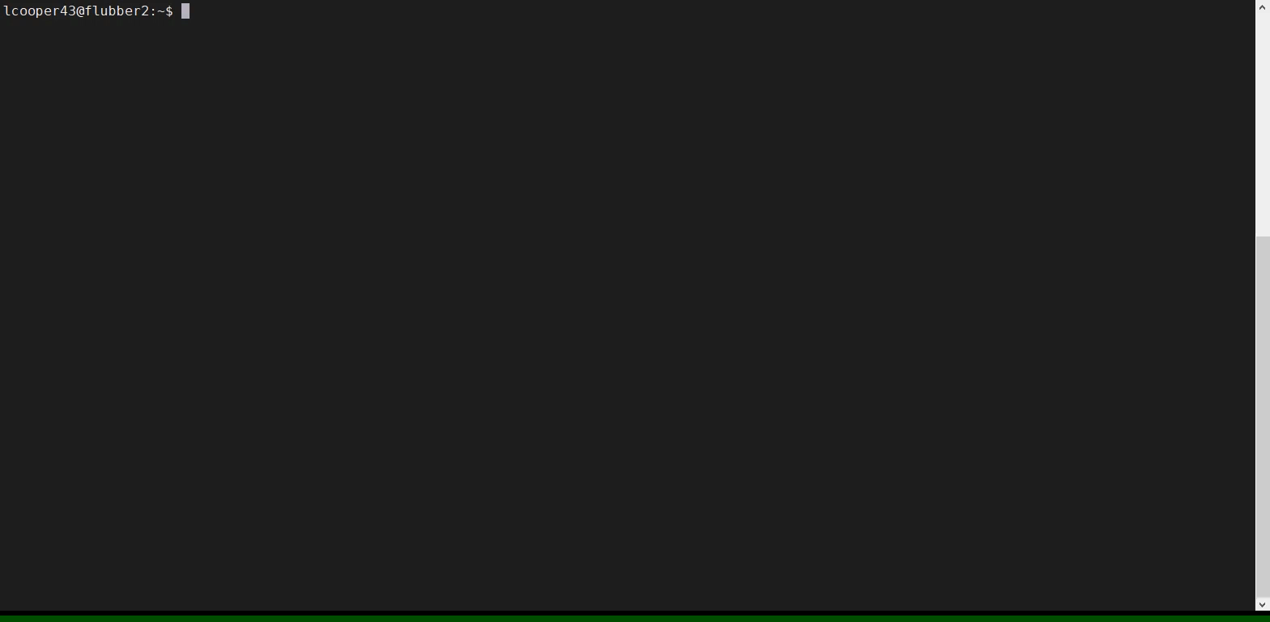
Notes:
5

Slide 6
Vortex Tutorial Assignments
https://github.com/vortexgpgpu/vortex_tutorials
Presenter: Liam Cooper
Notes:
6

Slide 7
Pre-exercise Setup: VM Download (Recommended)
Install VirtualBox and Vagrant
Download the Vagrant Box image from the tutorial repo
Add and initialize the Box image
Download the Vagrantfile from the tutorial repo
Boot the VM with vagrant up
Finally, run vagrant ssh to connect to VM
Detailed setup instructions in VM_README.md
Test Vortex:
./ci/blackbox.sh --cores=2 --app=demo
Notes:
7

Slide 8
Pre-exercise Setup: Remote Account in Browser
Log into rg-login.crnch.gatech.edu with provided login
ssh into flubber1
Clone the Vortex repo
Set up the environment variables
Run make
Detailed setup instructions in REMOTE_ACCESS.md
Will be available until the end of the conference
Test Vortex:
./ci/blackbox.sh --cores=2 --app=demo
Notes:
8

Slide 9
7 Tutorial Assignments
Vortex tutorial assignments
Designed to cover various aspects of Vortex
Warp efficiency performance counter
Assignments 1 & 2
Software prefetching
Assignments 3 & 4
Custom instruction for computing dot product
Assignments 5 & 6
Debugging Vortex
Assignment 7
Notes:
9

Slide 10
Blackbox
Vortex's main test driver
Arguments
Clusters, cores, warps, threads
L2cache, L3cache
Driver
rtlsim, simx, xrt, opae
Debug
Perf
App
Application to run
Args
Arguments to the application
Notes:
10

Slide 11
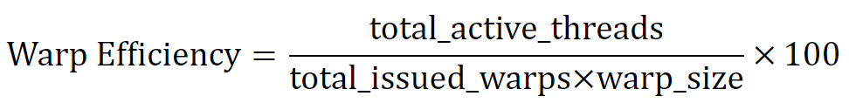
Assignment 1 & 2
Add a new performance counter for warp efficiency
Implement and use performance counters for total active threads and total issued warps
Reserve and register the CSR addresses for the new counters
Implement the logic for the total active threads and total issued warps counters
Expose the counters in the runtime for use in calculating the warp efficiency
Notes:
11

Slide 12
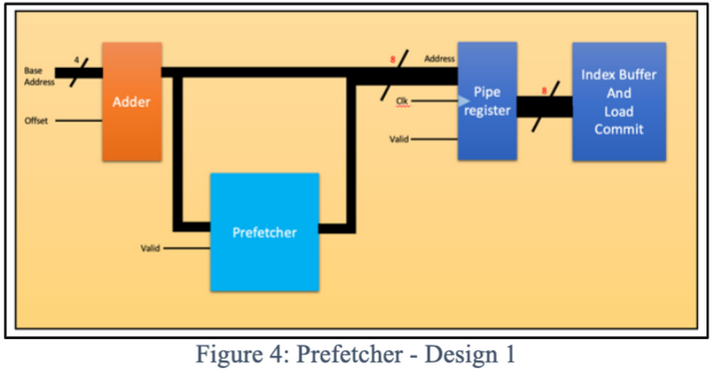
Assignment 3/4
Add a simple next line prefetcher in LSU
Every time a load request is computed, generate the next cache line address and send to d-cache
Request metadata must be stored somewhere so the processor knows the correct memory requested
Assignment 4 verifies implementation by showing how to debug to see if prefetch requests are generated and used correctly
Assignment 3 is already implemented in latest version of Vortex; use VM instead
Notes:
12

Slide 13
Assignment 5
Add a new instruction for prefetching
Add an intrinsic for the new instruction (to generate a binary with new instruction)
Define the new instruction in SimX
Extend the pipeline/decoder
Modify the LSU to take in prefetch instructions
Develop a test to check functionality of the new instruction
Debugging using kernel dump and run log
Already implemented in latest version of Vortex; use VM instead
Notes:
13

Slide 14
Checking Solutions for Assignments #3 & #5
Check solutions folder on Github
Solution overview and code provided
Download and execute solution
Solution code formatted as git pull requests
Assignment 3:
git fetch origin pull/22/head:A3_solution git checkout A3_solution
Assignment 5:
git fetch origin pull/25/head:A5_solution git checkout A5_solution
Notes:
14

Slide 15
Assignment 6
Add performance counters to test software prefetcher
Measure prefetch metrics
# of unique prefetch requests
# of unused prefetched blocks
# of late prefetches
Part #1: extending the cache tag
Part #2: extending bank.sv to keep track of the meta data
Notes:
15

Slide 16
Thank you
https://github.com/vortexgpgpu/vortex_tutorials
Notes:
16

